Slide 1

Construction managing system

Slide 2

Stake holders
Liron Hart - Main Client
Contractors and Work Managers - Users

Slide 3
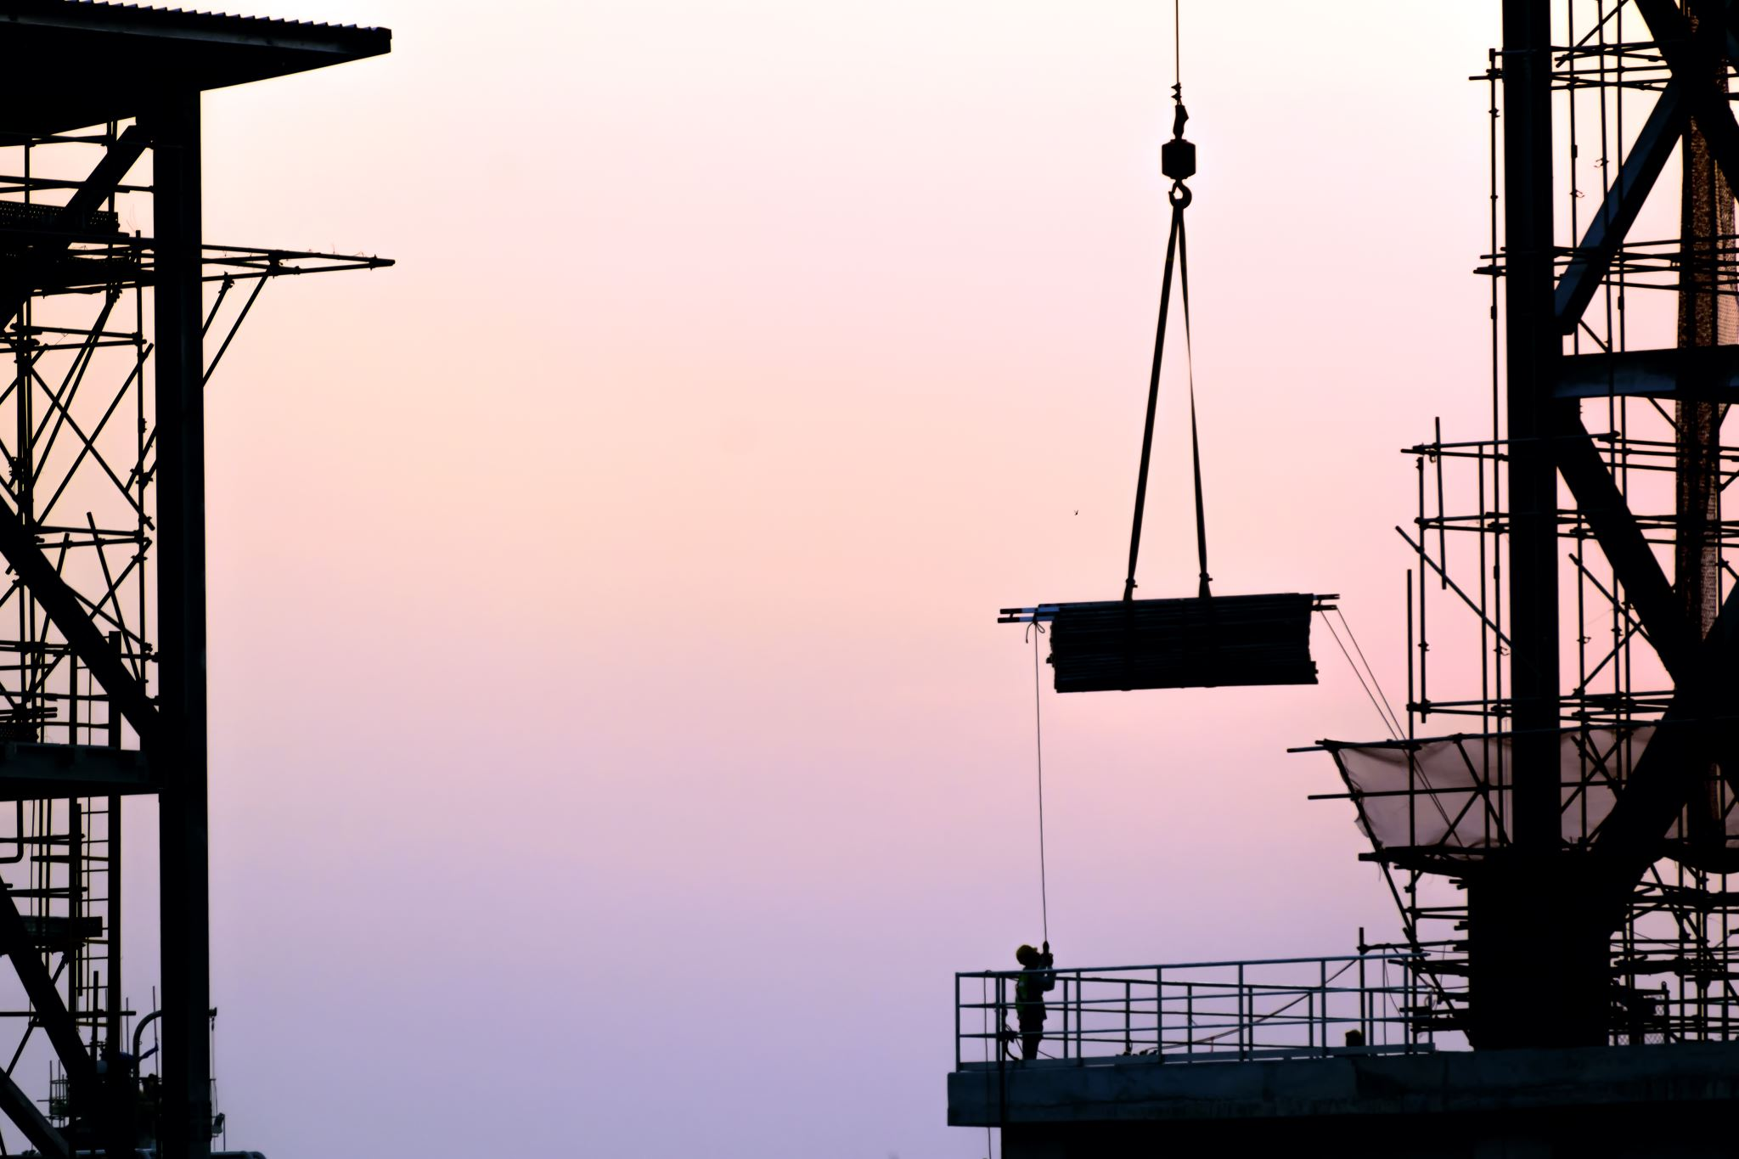

Problem Domain
Construction projects are complex processes that require tracking by the management.
Management can’t always be present in the field.
Sometimes proof of certain tasks are needed and asked for by the clients or authorities.
Reports are generated manually.

Slide 4

Our solution
Mobile application specifically tailored to our costumer’s needs.

Slide 5

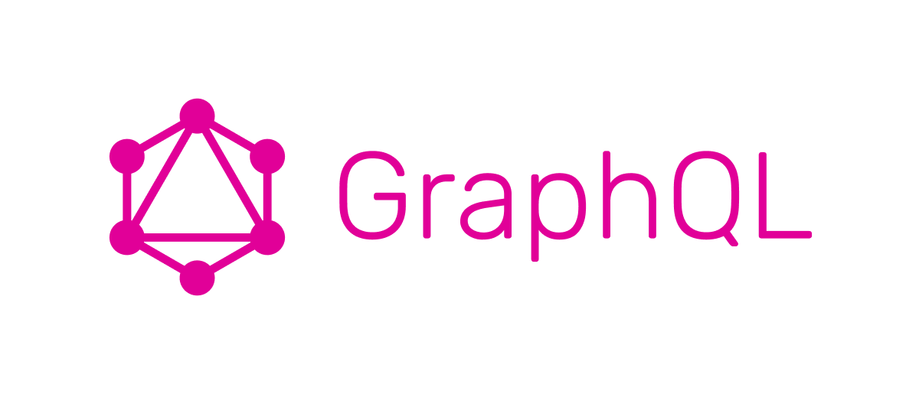
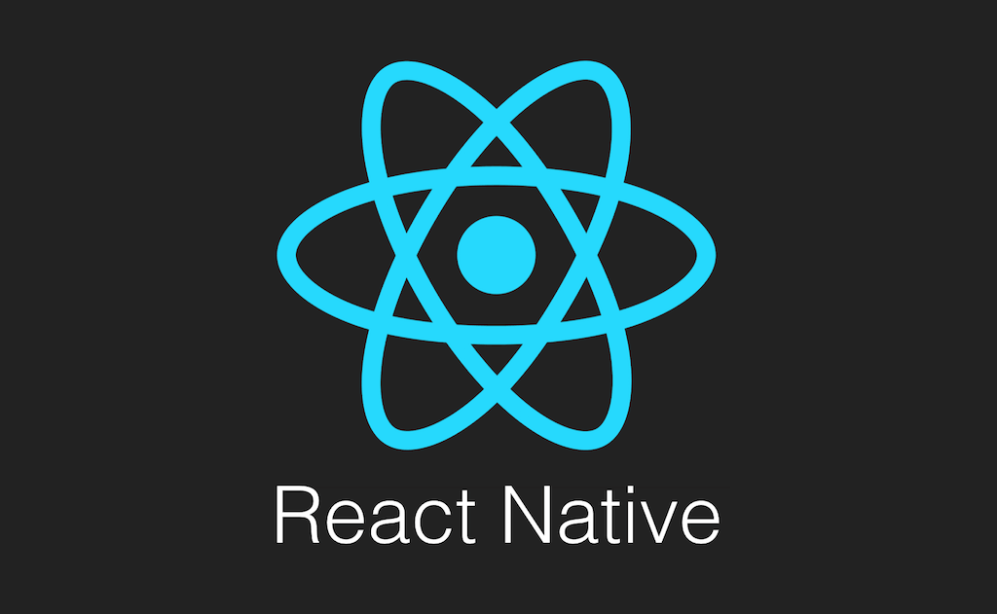
Early system design
DB - SQL
Remote server

Slide 6
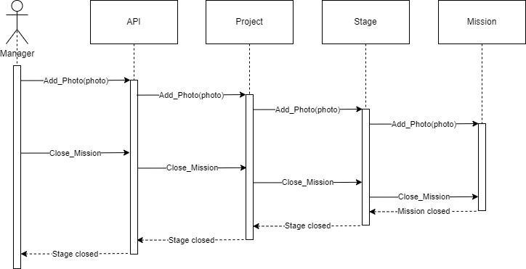
Main Use cases: Closing a last mission

Slide 7
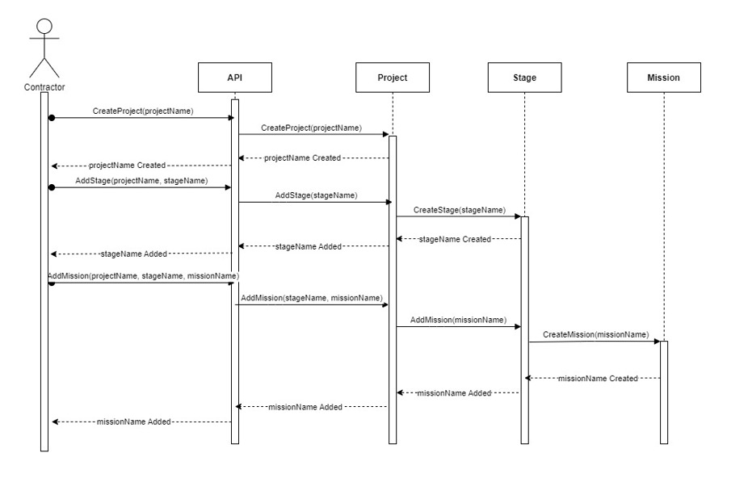
Main Use cases: Creating a project

Slide 8

Progression so far
Meetings with Liron.
ARD draft and University presentation.
Presenting our Requirements draft to Liron.
Improving on feedback.
Finalizing ARD.

Slide 9
Gantt Diagram:

